Slide 1

Project Benson Strategies for Optimizing Street Team Placement
Dean, Dereck, Joe, Kendall
01/22/2018
Delete Red Text

Slide 2
The Gala
Everybody contributes!!!
WomenTechWomenYes Summer Gala
Explain problem
Best times to place street teams?
Spring time and used data
How to best place street teams?
Used data to best figure out

Slide 3
Methodology
Everybody contributes!!!
Obtained data from http://www.mta.info/
Explain problems in data
Two methods to clean:
Interpolation
Split to every hour, then condense to hours we wanted, how we got rid of bad values
Weighted Average
Condense to every 4 hours, took median and assumed each turnstile for each station was approximately equal to get rid of bad values
Add more about how we picked stuff

Slide 4
Kendall/Joe
Results (Raw Output)

Slide 5
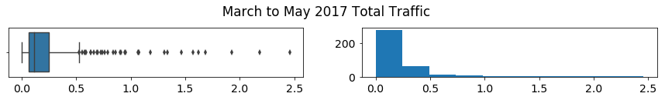

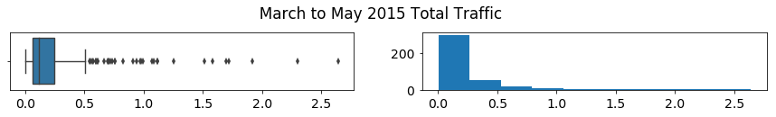
Kendall/Joe
Results
(all traffic totals in 10s of millions)

Slide 6
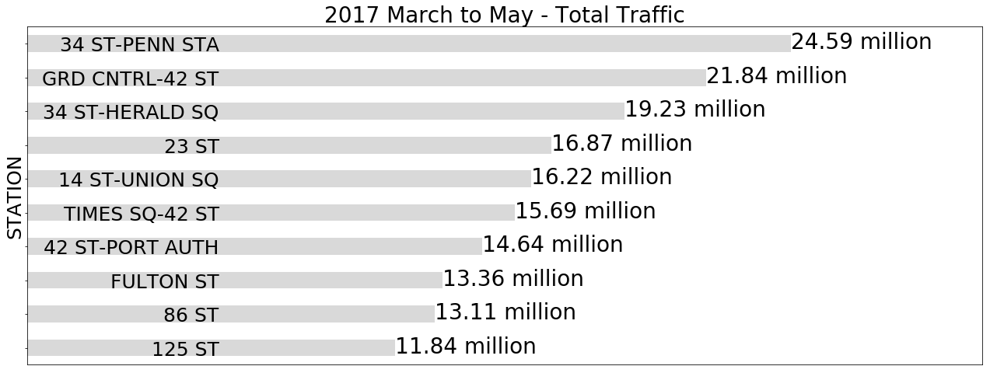
Kendall/Joe
Results (Raw Output)

Slide 7
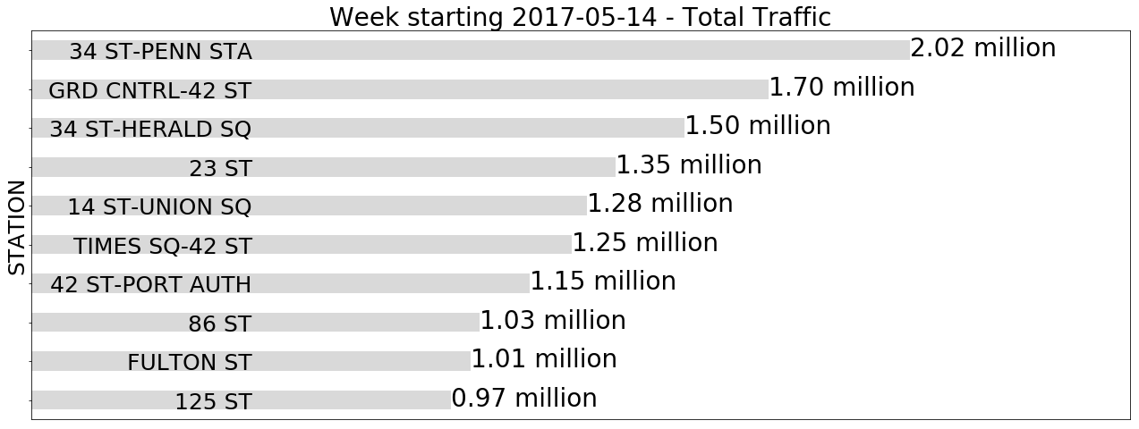
Kendall/Joe
Results (Raw Output)

Slide 8
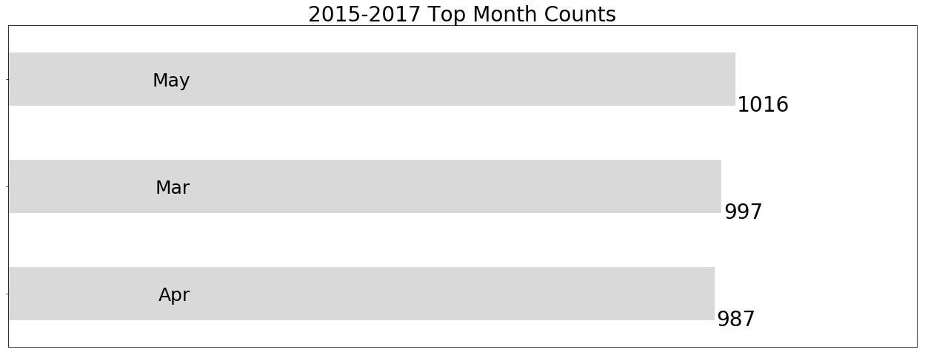
Dereck
Observations

Slide 9
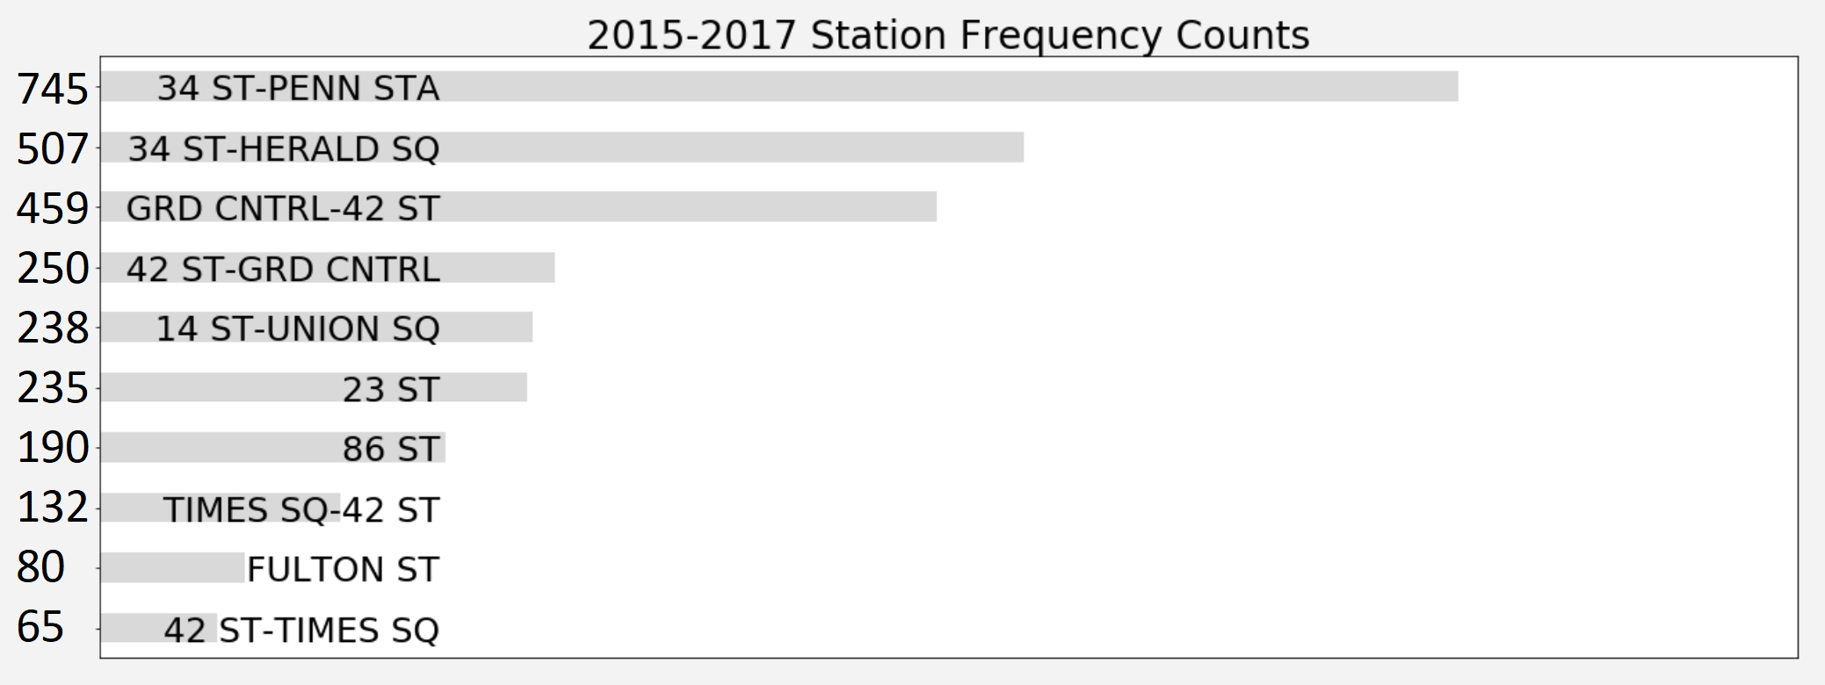
Dereck
Observations

Slide 10
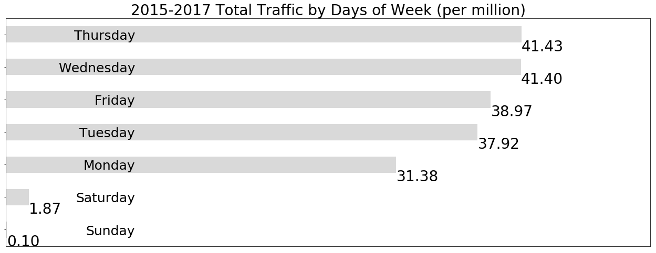
Dereck
Observations

Slide 11
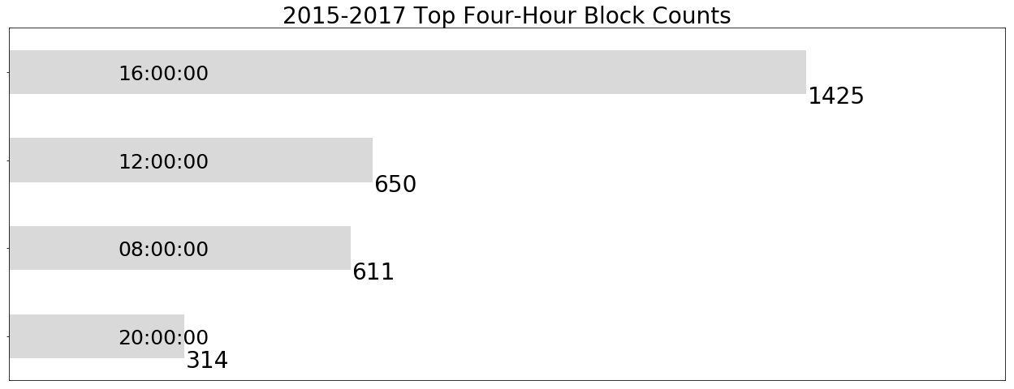
Dereck
Observations

Slide 12
Observations
Low rider volume on weekends
Marginal difference between months in our list
16:00 – 20:00 most optimal hour block

Slide 15
Dean
Results (Business Recommendations)

Slide 16
ALL
Next Steps (Possible Additional Analysis)
Everybody contributes!!!

Slide 17
Pictures

